Slide 1
可判定性
王炯达
1

Slide 2

前情提要
对于任意的输入$w$，一个图灵机运行它有三种可能的情况:
接受 $w$ ($进入 q\text{acc}$状态)
拒绝 $w$(进入 $q\text{rej}$状态 )
循环 (永不停机)
$一个语言A$是图灵可识别的，如果 $A=L(M)$ $对于某一图灵机M$.
$一个语言A$是图灵可判定的，$如果A=L(M)$ 对于某一判定器$M$.
对于多个对象 $O_{1}, O_{2}, …, O_{k}$ ，它们的编码是一个串$〈O_{1}, O_{2}, …, O_{k}〉$（图灵机的输入总是一个串）.
对于一切输入的串，总能决定接受还是拒绝而不是循环
2

Slide 3
可判定语言
——哪些语言是可判定的？
1

Slide 4






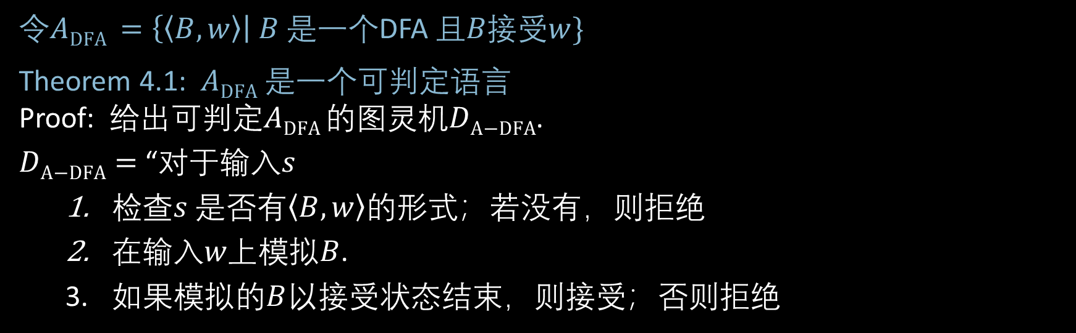

关于正则语言：DFA(确定性有穷自动机)接受问题
$令A\text{DFA} =\left\{〈B,w〉\right| B$ 是一个DFA 且$B接受w\}$
Theorem 4.1: $A\text{DFA}$是一个可判定语言
Proof: $给出可判定A\text{DFA}$的图灵机$D\text{A}\text{−}\text{DFA}$.
$D\text{A}\text{−}\text{DFA}=$ “$对于输入s$
$检查s$ 是否$有〈B,w〉$的形式；若没有，则拒绝
$在输入w上模拟B$.
如果模拟的$B$以接受状态结束，则接受；否则拒绝
简写: $对于输入〈B,w〉$
$$输入〈B,w〉$$
$$\left(Q=\left\{q_{0}, …,q_{k}\right\}, Σ=\left\{0,1\right\}, δ=⋯, q_{0}, =⋯\right), w=01101$$
$$D\text{A}\text{−}\text{DFA}$$
$$q_{i }, k$$
$$B$$
$$w$$
当前状态&读写头位置
3

Slide 5

NFA接受问题
$$令A\text{NFA} =\left\{〈B,w〉\right|B \text{是一个}\text{DFA} \text{且}B接受w\}$$
Theorem 4.2: $A\text{N}\text{FA}\text{是一个可判定语言}$
Proof: $给出D\text{A}\text{−}\text{NFA}$ $能够判定A\text{N}\text{FA}$.
$D\text{A}\text{−}\text{NFA}=$ “$对于输入〈B,w〉$
将NFA $B$转换为等价的DFA $B′$
$在输入〈B′,w〉$上运行$D\text{A}\text{−}D\text{FA}$. [$D\text{A}\text{−}\text{DFA}$ $可判定A\text{D}\text{FA}$ ]
$若D\text{A}\text{−}\text{DFA}$接受则接受；否则拒绝
核心思路：用前面构建过的图灵机作为当前图灵机的子程序
4

Slide 6
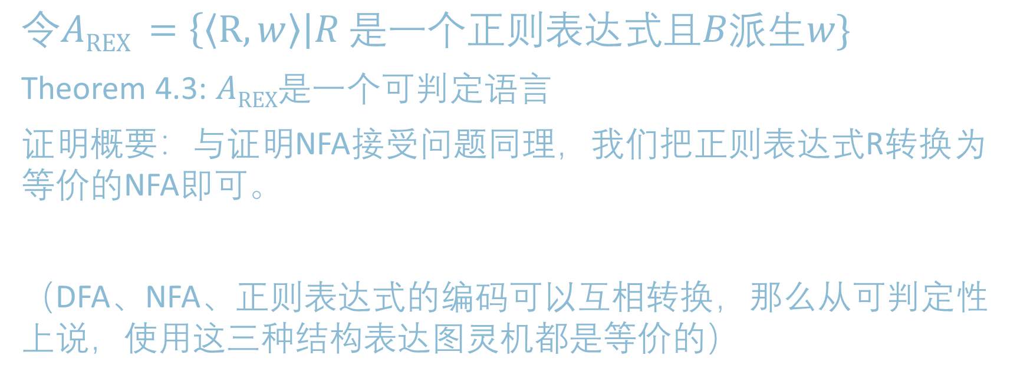
正则表达式接受问题
$$令AREX =\left\{〈R,w〉\right|R \text{是一个}正则表达式\text{且}B派生w\}$$
Theorem 4.3: $AREX\text{是一个可判定语言}$
证明概要：与证明NFA接受问题同理，我们把正则表达式R转换为等价的NFA即可。
（DFA、NFA、正则表达式的编码可以互相转换，那么从可判定性上说，使用这三种结构表达图灵机都是等价的）
4

Slide 7

DFA的空性质判定
令 $E\text{DFA}=\left\{〈B〉\right| B$是一个DFA 且 $L\left(B\right)=∅\}$
Theorem 4.4: $E\text{D}\text{FA}$是可判定语言
Proof: 给出$判定E\text{DFA}$ 的图灵机 $D\text{E}\text{−}\text{DFA}$
$D\text{E}\text{−}\text{DFA}=$ “$对于输入〈B〉$
标记起始状态
重复以下步骤直到没有新的状态被标记:
对于每一个状态，若存在一个到达它的转移从某个已经标记的状态出发，则将其标记（连通图检测？）.
如果没有接受状态被标记，则接受；否则拒绝
思路：能否找到一条从起始状态到接受状态的路径？
5

Slide 8



DFA等价性问题
$令EQ\text{DFA}$ $=\{〈A,B〉|$ $A$和$B$是DFA$且L\left(A\right)=L\left(B\right)\}$
Theorem4.5: $EQ\text{D}\text{FA}$是可判定语言
Proof: 给出$可判定EQ\text{DFA}$ 的图灵机 $D\text{E}\text{Q}\text{−}\text{DFA}$
$D\text{E}\text{Q}\text{−}\text{DFA}=$ “$对于输入〈A,B〉$
构造DFA $C$ 使得$L\left(C\right)=\left(L\left(A\right)∩\overline{L\left(B\right)}\right)∪\left(\overline{L\left(A\right)}∩L\left(B\right)\right)$.
在 $〈C〉$上运行 $D\text{E}\text{−}\text{DFA}$（空性质判定图灵机） .
$若D\text{E}\text{−}\text{DFA}$接受则接受；否则拒绝。
思路：构造DFA让它接受A与B结果不同的串，若不存在使A和B结果不同的输入，说明A和B接受同样的语言。
$$L\left(A\right)$$
$$L\left(B\right)$$
Symmetric difference
6

Slide 9


关于上下文无关语言：
CFG(上下文无关文法)接受问题
Let $A\text{CFG} =\{〈G,w〉| G是一个\text{CF}\text{G}且L\left(G\right)派生w\}$ Theorem4.6: $\text{A}\text{CFG}$is decidable
Proof: $给出D\text{A}\text{−}\text{CFG}$ $判定A\text{CFG}$ .
$D\text{A}\text{−}\text{CFG}=$ “对于输入 $〈G,w〉$
转换 $G$为一个等价的CNF（乔姆斯基文法）.
$列出所有长度2|w|−1$的派生.
Accept if any generate $w$. Reject if not.
Corollary: 每一个CFL 都是可判定的.
Proof: Let $A$ be a CFL, generated by CFG $G$.
Construct TM $M_{G}=$“on input $w$
1. Run $D\text{A}\text{−}\text{CFG}$ on $〈G,w〉$.
2. Accept if $D\text{A}\text{−}\text{CFG}$ accepts Reject if it rejects.”
Recall Chomsky Normal Form (CNF) only allows rules: A $→$ BC
B $→$ b
Lemma 1: Can convert every CFG into CNF.
Proof and construction in book.
Lemma 2: If $H$ is in CNF and $w∈L(H)$ then every derivation of $w$ has $2|w|−1$ steps.
7

Slide 10


CFG的空性质判定
Let $E\text{CFG}$ $=\{〈G〉| G$ is a CFG and $L\left(G\right)=∅ \}$
Theorem: $E\text{CFG}$is decidable
Proof: $D\text{E}\text{−}\text{CFG}=$ “On input $〈G〉$ [IDEA: work backwards from terminals]
Mark all occurrences of terminals in $G$.
Repeat until no new variables are marked
Mark all occurrences of variable A if A $→B_{1}B_{2}⋯B_{k}$ is a rule and all $B_{i}$ were already marked.
Reject if the start variable is marked. Accept if not.”
S $→$ RTa
R $→$ Tb
T $→$ a
S
R
T
a
R
T
b
T
a
8

Slide 11
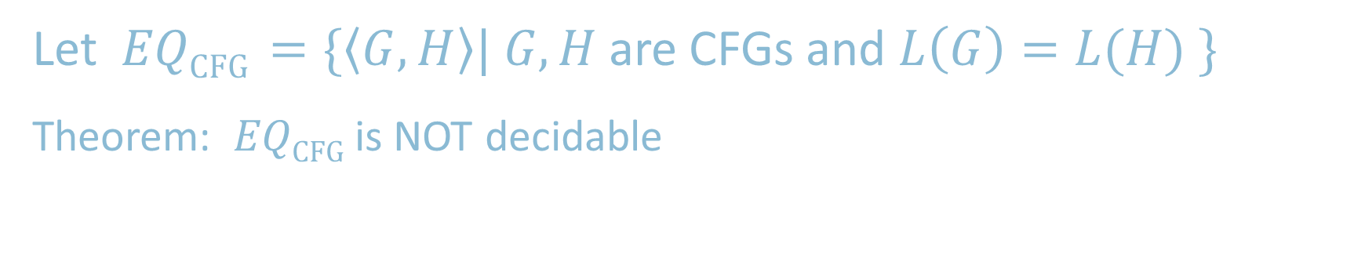
Equivalence Problem for CFGs
Let $EQ\text{CFG}$ $=\{〈G,H〉| G,H$ are CFGs and $L\left(G\right)=L(H) \}$
Theorem: $EQ\text{CFG}$is NOT decidable
Proof: next week
9

Slide 12
不可判定性
——什么是不可判定的？
1

Slide 13



Acceptance Problem for TMs
Let $A\text{TM}$ $=\{〈M,w〉| M$ is a TM and $M$ accepts $w\}$
Theorem: $A\text{TM}$is T-recognizable
Proof: The following TM $U$ recognizes $A\text{TM}$
$U=$ “On input $〈M,w〉$
Simulate $M$ on input $w$.
Accept if $M$ halts and accepts.
Reject if $M$ halts and rejects.
Reject if $M$ never halts.”
Von Neumann said $U$inspired the concept of a stored program computer.
Turing’s original “Universal Computing Machine”
Description of $M$, input $w$
$$U$$
Not a legal TM action.
10

Slide 14
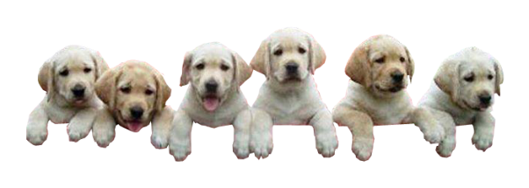
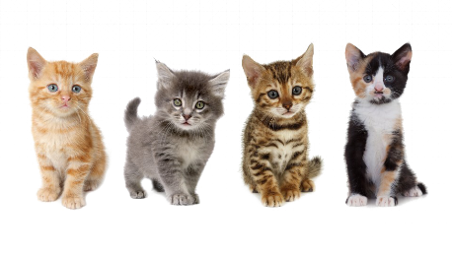

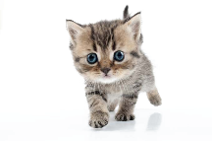




无限集合的规模
怎样比较无穷集合的规模?
Cantor (~1890s) had the following idea.
Defn: Say that set $A$ and $B$ have the same size if there is a one-to-one and onto function $f:A→B$ （既单射又满射）
如果两个集合存在一一对应，那么认为这两个集合规模相同.
（对于无穷集合也是如此！）
$$x≠y→$$
$$f\left(x\right)≠f\left(y\right)$$
“injective”
Range $(f)=B$ “surjective”
We call such an $f$ a 1-1 correspondence(一一对应)
$f$:
3

Slide 15




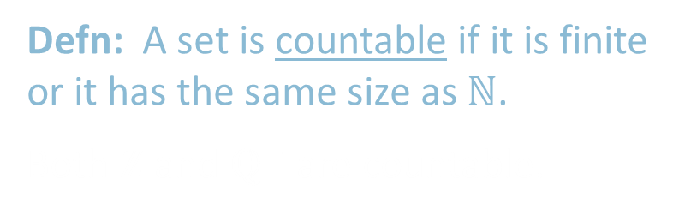


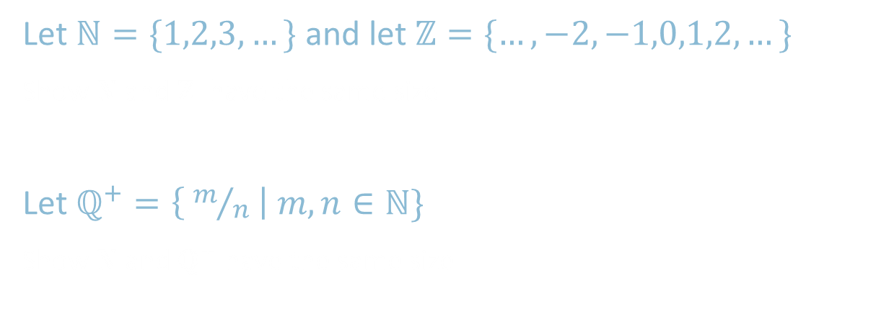

Countable Sets（可数集）
Let $ℕ=\{1,2,3,…\}$ and let $ℤ=\{…,−2,−1,0,1,2,…\}$
Show $ℕ$and $ℤ$ have the same size
Let $ℚ^{+}=\left\{ m/n \right| m,n∈ℕ\}$
Show $ℕ$ and $ℚ^{+}$ have the same size
$$n$$ | $$f(n)$$
1 | 0
2 | -1
3 | 1
4 | -2
5 | 2
6 | -3
7 | 3
$⋮$ | $⋮$
$$ℕ$$
$$ℤ$$
$$n$$ | $$f(n)$$
1 | 1/1
2 | 2/1
3 | 1/2
4 | 3/1
5 | 3/2
6 | 2/3
7 | 1/3
$⋮$ | $⋮$
$$ℚ^{+}$$ | 1 | 2 | 3 | 4 | …
1 | 1/1 | 1/2 | 1/3 | 1/4
2 | 2/1 | 2/2 | 2/3 | 2/4 | …
3 | 3/1 | 3/2 | 3/3 | 3/4
4 | 4/1 | 4/2 | 4/3 | 4/4
$$⋮$$ |  | $$⋮$$
$$ℕ$$
$$ℚ^{+}$$
Defn: A set is countable if it is finite or it has the same size as $ℕ$.
Both $ℤ$ and $ℚ^{+}$ are countable.
4

Slide 16
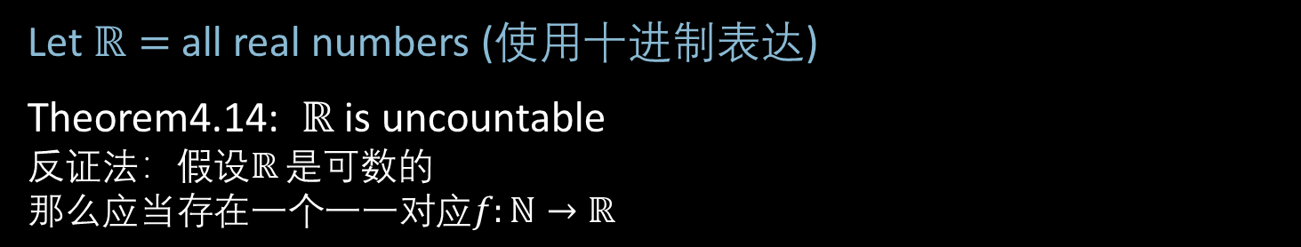


$ℝ$ is Uncountable – Diagonalization(对角化方法)
Let $ℝ=$all real numbers (使用十进制表达)
Theorem4.14: $ℝ$ is uncountable
$反证法：假设ℝ$ 是可数的
$$那么应当存在一个一一对应f:ℕ→ℝ$$
$$n$$ | $$f(n)$$
1 | 2.718281828…
2 | 3.141592653…
3 | 0.000000000…
4 | 1.414213562…
5 | 0.142857242…
6 | 0.207879576…
7 | 1.234567890…
$⋮$ | $$⋮$$
Demonstrate a number $x∈ℝ$ that is missing from the list.
$x=$ 0.8516182…
differs from the $n$^{th} number in the $n$^{th} digit so cannot be the $n$^{th} number for any $n$.
Hence $x$ is not paired with any $n.$ It is missing from the list.
Therefore $f$ is not a 1-1 correspondence.
7
≠4
≠7
≠0
≠2
≠5
≠9
≠8
4
0
2
5
9
8
Diagonalization
5

Slide 17



$ℝ$ is Uncountable – Corollaries
Let $ℒ=$all languages（所有语言的集合）
Corollary 4.15: $ℒ$ is uncountable
Proof: There’s a 1-1 correspondence from $ℒ$to $ℝ$ so they are the same size.
Observation: $Σ^{∗}=\{ε, 0,1,00,01,10,11,000, …\}$ is countable. (01序列的集合是可数的)
Let $ℳ=$all Turing machines
Observation: $ℳ$ is countable.
Because $\left\{〈M〉\right| M$ is a TM$\}⊆Σ^{∗}$.
(任何图灵机都可以编码成01序列)
Corollary 2: Some language is not decidable.(存在不能被图灵机识别的语言)
Because there are more languages than TMs.
We will show some specific language $A\text{TM}$ is not decidable.
$$Σ^{∗}$$ | {$ε$, | 0, | 1, | 00, | 01, | 10, | 11, | 000, | …
$$A∈ℒ$$ | { | 0, |  | 00, | 01, |  |  |  | …
$$f\left(A\right)$$ | .0 | 1 | 0 | 1 | 1 | 0 | 0 | 0 | …
6

Slide 18


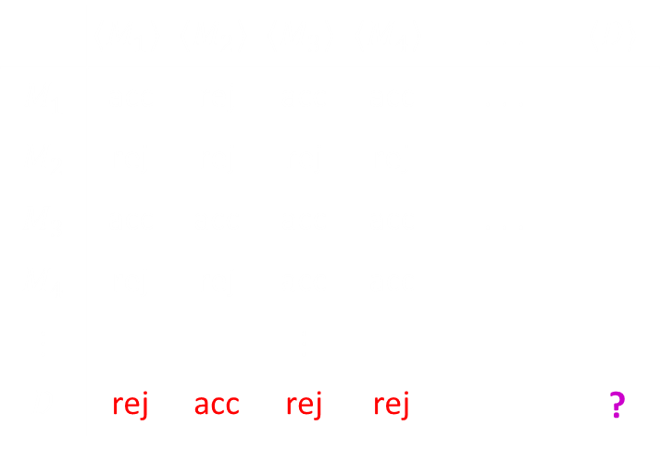
$A\text{TM}$ is undecidable
Recall $A\text{TM}$ $=\{〈M,w〉| M$ is a TM and $M$ accepts $w\}$
Theorem4.9: $A\text{TM}$is not decidable
Proof by contradiction: Assume some TM $H$ decides $A\text{TM}$.
So $H$ on $〈M,w〉=\left\{\begin{aligned}\text{Accept} \text{if} M \text{accepts} w \\ \text{Reject} \text{if} \text{not} \end{aligned}\right.$
Use $H$ to construct TM $D$
$D=$“On input $〈M〉$
1. Simulate $H$ on input $〈M,〈M〉〉$
2. Accept if $H$ rejects. Reject if $H$ accepts.”
$D$ accepts $〈M〉$ iff $M$ doesn’t accept $〈M〉$ .
$D$ accepts $〈D〉$ iff $D$ doesn’t accept $〈D〉$ .
Contradiction.
Why is this proof a diagonalization?
All TMs
All TM descriptions:
 | $$〈M_{1}〉$$ | $$〈M_{2}〉$$ | $$〈M_{3}〉$$ | $$〈M_{4}〉$$ | . . . | $$〈D〉$$
$$M_{1}$$ | acc | rej | acc | acc | . . .
$$M_{2}$$ | rej | rej | rej | rej
$$M_{3}$$ | acc | acc | acc | acc | . . .
$$M_{4}$$ | rej | rej | acc | acc
$$⋮$$ |  |  | $$⋮$$
$$D$$ | rej | acc | rej | rej |  | ?
acc
rej
acc
acc
7

Slide 19




$\overline{A\text{TM}}$ is T-unrecognizable
Theorem: If $A$ and $\overline{A}$ are T-recognizable then $A$ is decidable
Proof: Let TM $M_{1}$ and $M_{2}$ recognize $A$ and $\overline{A}$.
Construct TM $T$ deciding $A$.
$T=$ “On input $w$
1. Run $M_{1}$ and $M_{2}$ on $w$ in parallel until one accepts.
2. If $M_{1}$ accepts then accept. If $M_{2}$ accepts then reject.”
Corollary: $\overline{A\text{TM}}$ is T-unrecognizable
Proof: $A\text{TM}$ is T-recognizable but also undecidable
Complement of T-recognizable = co-T-recognizable
T-recognizable
$$\overline{A\text{TM}}$$
$A\text{TM}$
decidable
9

Slide 20

Quick review of today
We showed the decidability of various problems about automata and grammars: $A\text{DFA}$ , $A\text{N}\text{FA}$ , $E\text{DFA}$ , $EQ\text{DFA}$ , $A\text{CFG}$ , $E\text{DFA}$
We showed that $A\text{TM}$ is T-recognizable.
11

